Slide 1
adCore University
LONDON
The New Reporting Exercise

Slide 2
Exercise 1
LONDON
You are planning a daily dashboard for yourself so you can measure the performance of the campaigns that you’re managing. This dashboard will be sent to you every morning before you come into the office. What charts would you include and what would you compare?

Slide 3
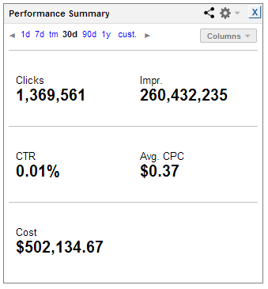
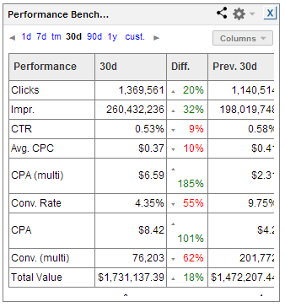
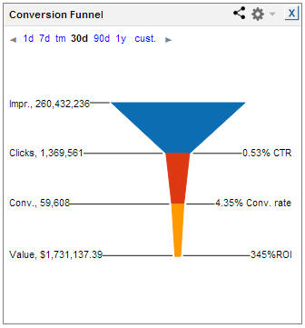
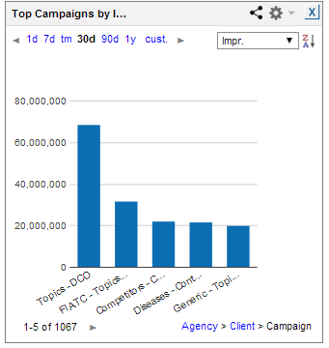
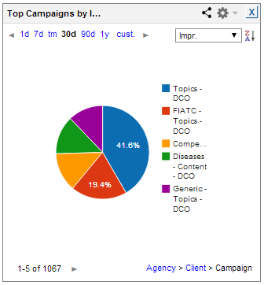
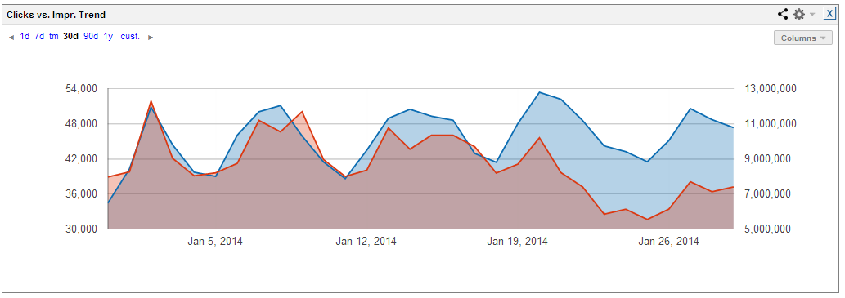
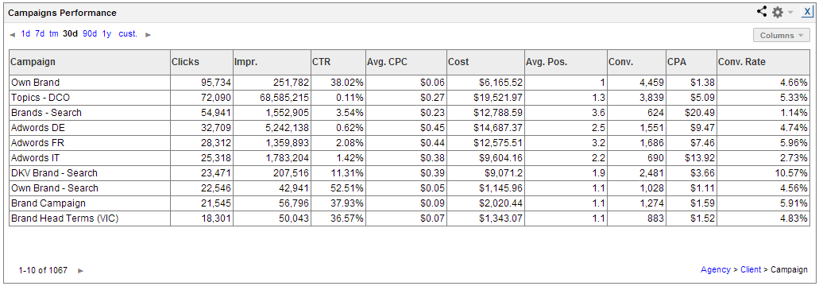
Cheat Sheet
LONDON

Slide 4
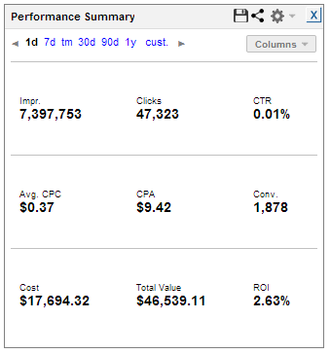
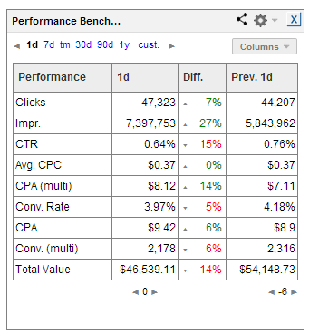
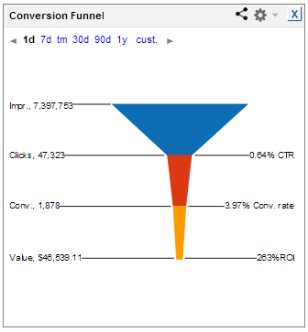
Exercise 1 Answer
LONDON

Slide 5
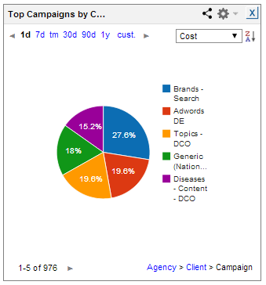
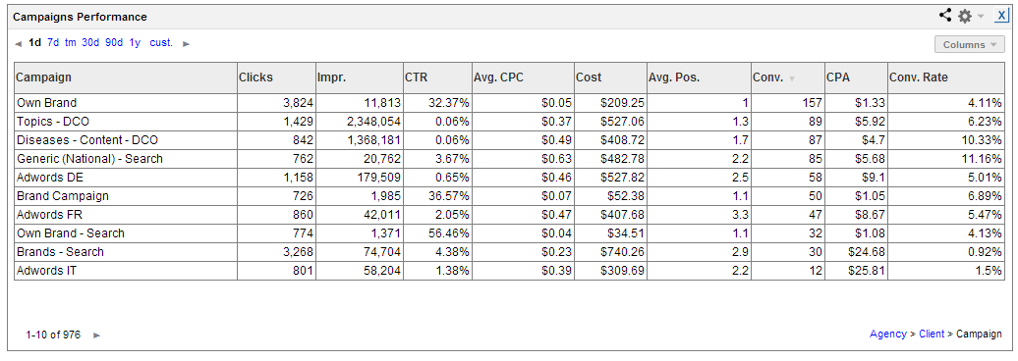
Exercise 1 Answer
LONDON

Slide 6
Exercise 2
LONDON
You are planning a monthly dashboard that will be sent to your clients at the end of every month. What reports would this dashboard include?
Notes:
We have a new reporting system that has just been released. You’ll get a full tour a bit later.

Slide 7
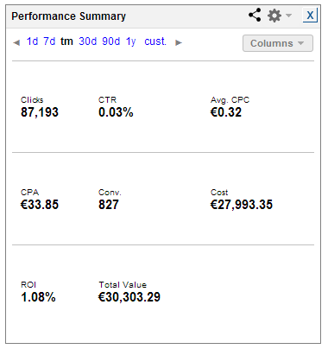
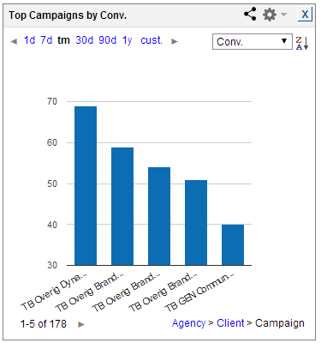
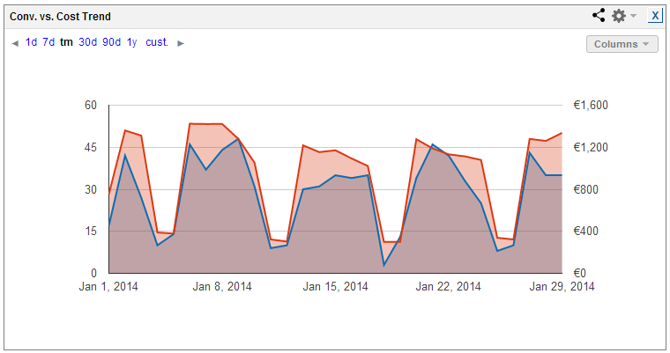
Exercise 2 Answer
LONDON

Slide 8
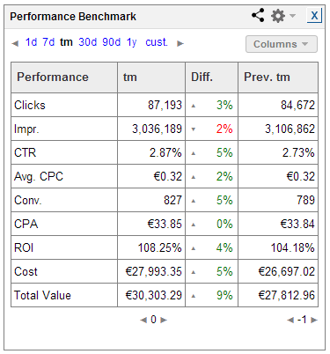
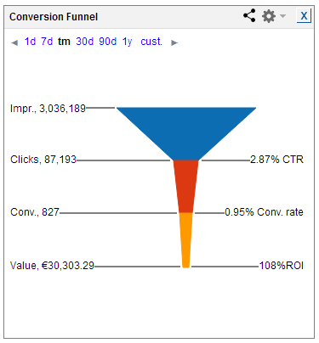
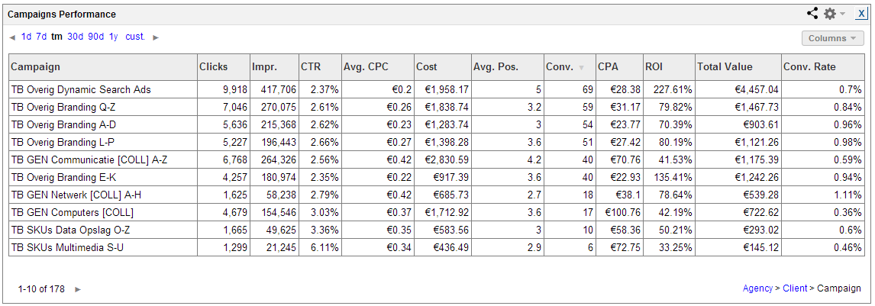
Exercise 2 Answer
LONDON

Slide 9
Exercise 3
LONDON
You are the SEM manager for an online electronics shop. You've started two brand new long-tail campaigns. In order to make sure the campaigns are profitable, it's important for you to notice the number of conversions. What kind of a report will make it easy for you to identify your campaign's progress?
Notes:
We have a new reporting system that has just been released. You’ll get a full tour a bit later.

Slide 10
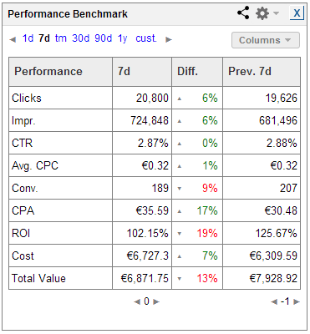
Exercise 3 Answer
LONDON

Slide 11
It’s Not Too Late
LONDON
We welcome your input!
Email support@adcore.com
to submit ideas.
Notes:
I want to emphasize once again that we welcome your ideas. Please email us at support@adCore.com or tell us personally what you think should be changed or improved. We take your feedback very seriously, so please don’t hesitate to let us know what’s on your mind.

Slide 12
The New Reporting
LONDON
Now Launched by Your Favorite SEM Tool…
Notes:
Thanks you once again for your time. We are doing our best to allow you to create tailor-made SEM reports on a grand scale.

